Slide 1
Optical communications and data networks (EENGM2001) Week13_Lecture007_ASync_ModulationDevices
Siddarth K Joshi

Slide 2
Optical Modulation
Absorptive
Refractive
Spatial
Electro absorption
Chopper
Electro-Optic
Acousto-Optic
Magneto-Optic
Liquid Crystal
Spatial light modulators (SLM)
Transmissive or reflective
Interferometers can also be used to modulate light.

Slide 3
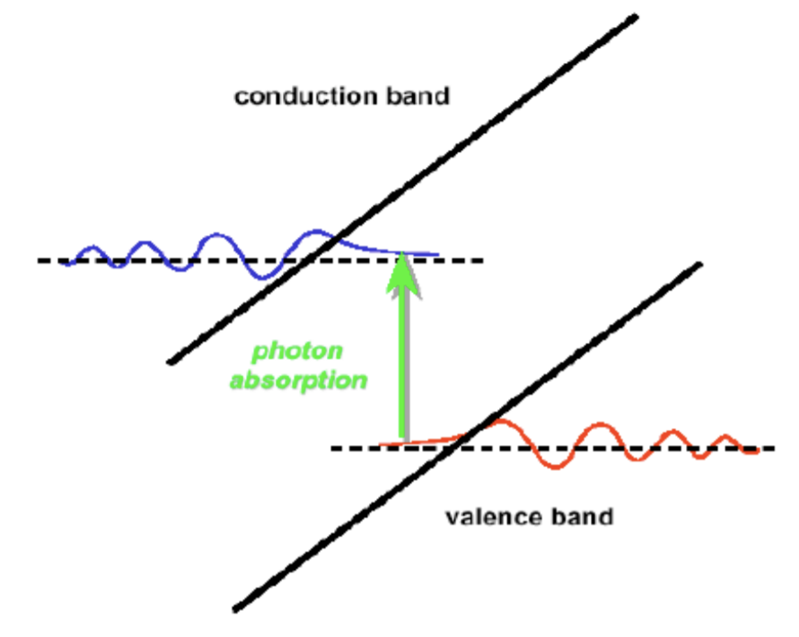
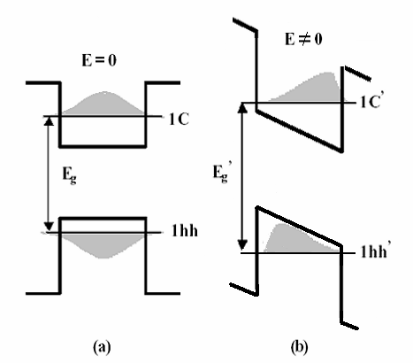
Electro absorption modulator (EAM)
Franz–Keldysh effect:
Occurs in semi conductors.
Electric field causes a tilt in the band gap.
Tunnelling allows photons of lower energy to be absorbed
Similar to Stark effect for atoms
I.e. Apply electric field to decrease transmission
Quantum-confined Stark effect:
Occurs in a quantum well.
Electric field causes a tilt in the band gap.
Stark effect lowers valence band ground state and increases conduction band ground state
I.e. Apply electric field to increase transmission
For more information see: https://www3.nd.edu/~gsnider/ee698a/rajkumar_opt_mod.pdf

Slide 4
Electro absorption modulator (EAM)
Typically used in waveguides to minimise the electric field needed.
Uses III-V semiconductors
Needs longer interaction length for a good extinction ratio
Trade-off between propagation loss and extinction ratio
Polarisation independent
Good for high speed amplitude modulation with low optical powers.
Why would such a technique only be suitable for low optical powers?
For more information see: https://www3.nd.edu/~gsnider/ee698a/rajkumar_opt_mod.pdf

Slide 5
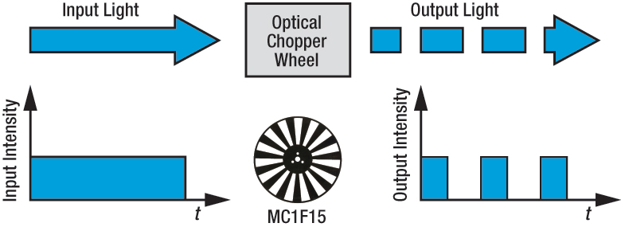
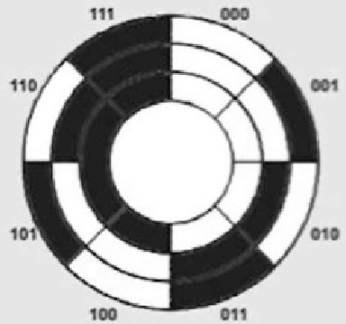
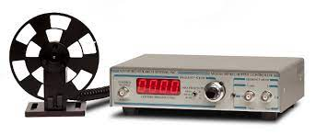
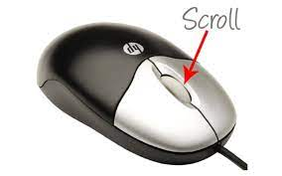
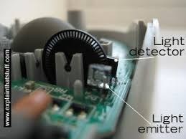
Chopper
Mechanical motion of wheel periodically blocks light.
Slow speed modulation only
Used for position encoding or human interface devices
E.g. Scroll wheel on a mouse.

Slide 6
Optical Modulation
Absorptive
Refractive
Spatial
Electro absorption
Chopper
Electro-Optic
Acousto-Optic
Magneto-Optic
Liquid Crystal
Spatial light modulators (SLM)
Transmissive or reflective
Interferometers can also be used to modulate light.

Slide 7
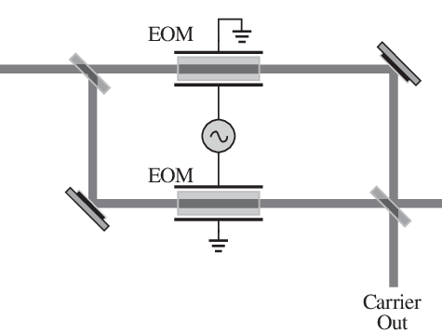
Electro Optic Modulator (EOM)
Change of refractive index with electric field
Many materials like crystals or organic polymers are not isotropic.
Thus the refractive index is a tensor
Called Non linear optical materials
Can modulate amplitude, phase, frequency and polarisation
Very versatile & high speed.
Polarisation dependent.
High extinction ratios.
Phase EOM used in Mach Zehnder Interferometer for amplitude modulation

Slide 8
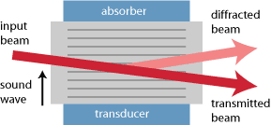
Acousto Optic Modulator (AOM)
Sound wave creates Bragg grating in material
(a.k.a. Bragg Cells)
Used to modulate direction of beam
E.g. used in Q-Switched lasers
Typically use Piezo transducers.
Slow (typically < 1MHz)
Diffracted beam changes frequency depending on acoustic wave frequency
Power of acoustic wave controls diffracted optical power
Lower energy efficiency --- because the sound wave needs to be damped strongly
Special applications for telecom E.g. Noise eater, beam stabilisation, etc.

Slide 9
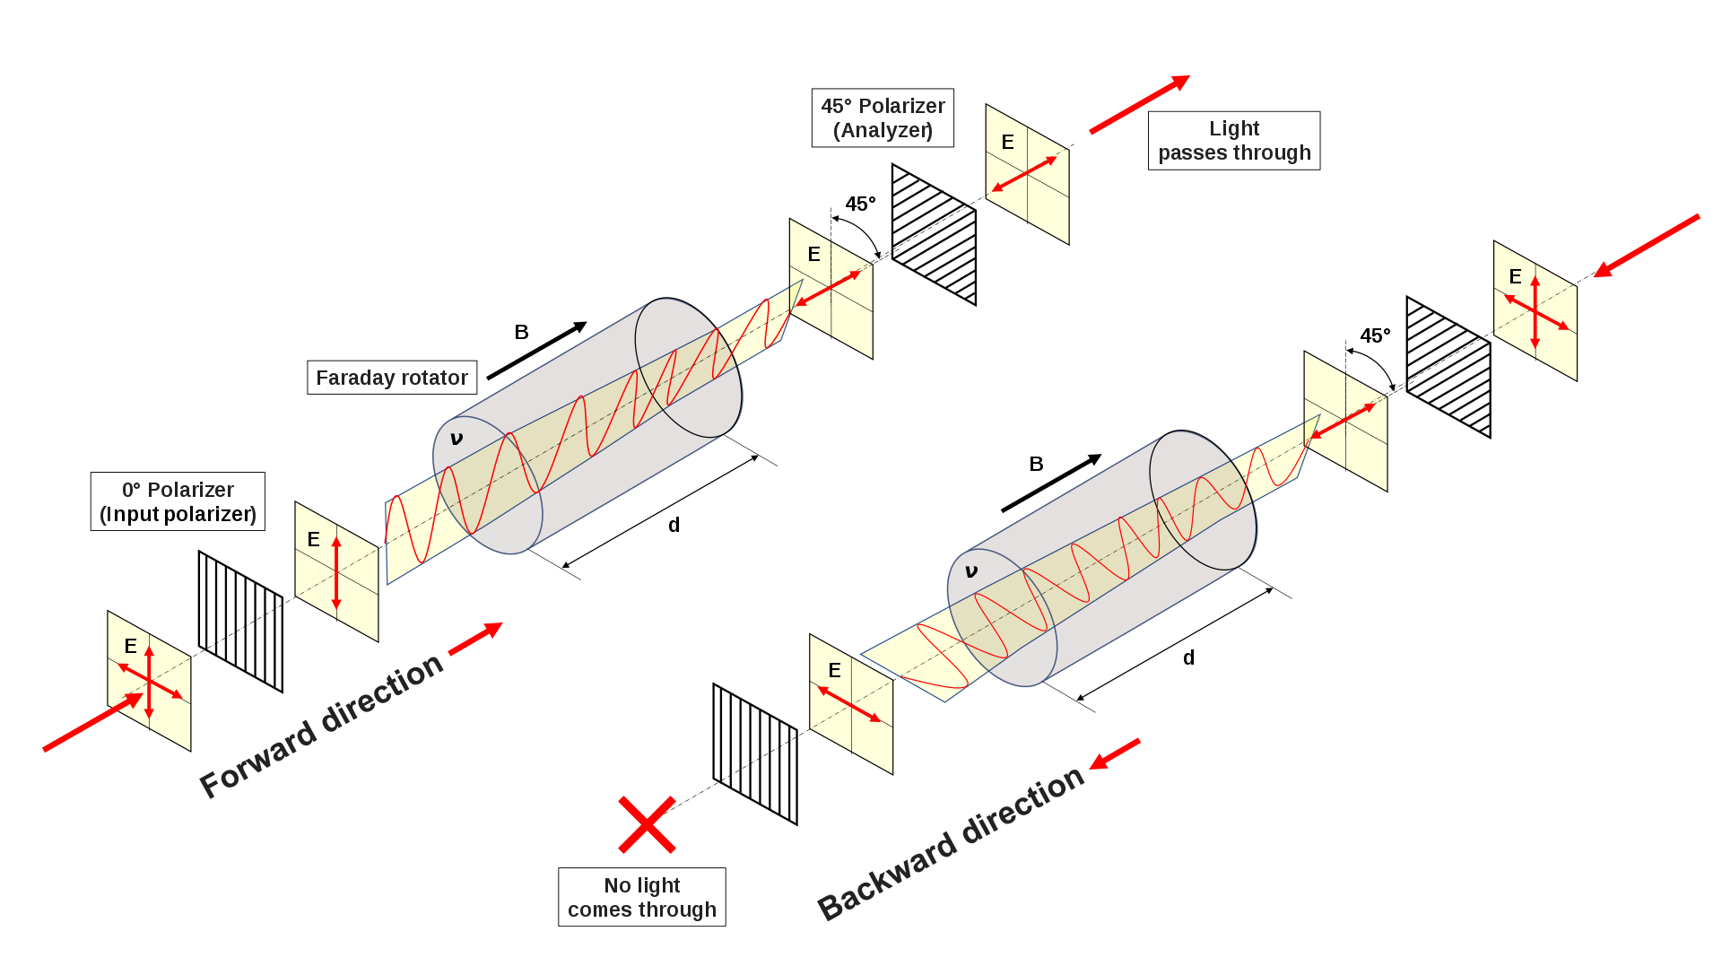
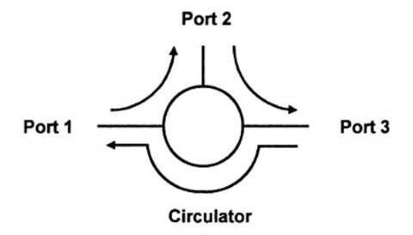
Magneto Optic Modulator (MOM)
Optical Isolator
Based on Faraday effect: Rotation of polarisation based on direction of travel of light through a medium with a high magnetic field applied.
Optical Circulator
Very slow speed or passive devices only
Fast switching of magnetic fields induces electronic noise.

Slide 10
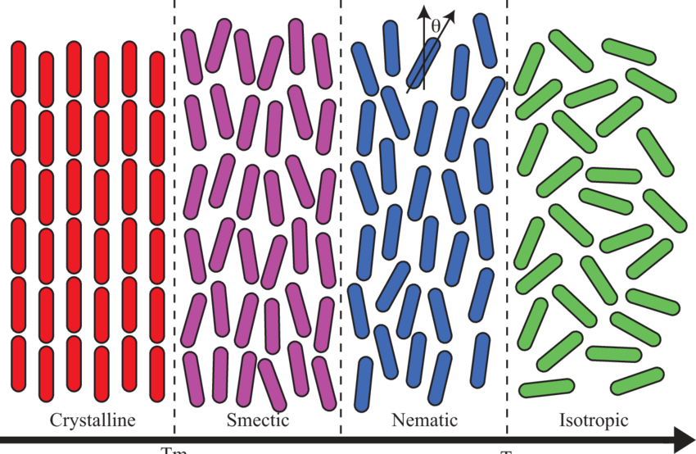
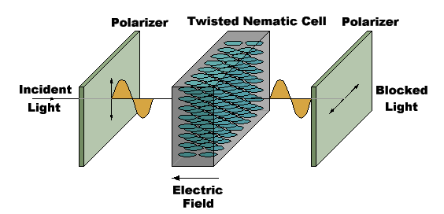
Liquid Crystals
Apply electric field to induce phase transition.
I.e. Act like different polarisation filters
V. Low cost.
Slow speeds only << 10KHz

Slide 11
Optical Modulation
Absorptive
Refractive
Spatial
Electro absorption
Chopper
Electro-Optic
Acousto-Optic
Magneto-Optic
Liquid Crystal
Spatial light modulators (SLM)
Transmissive or reflective
Interferometers can also be used to modulate light.

Slide 12
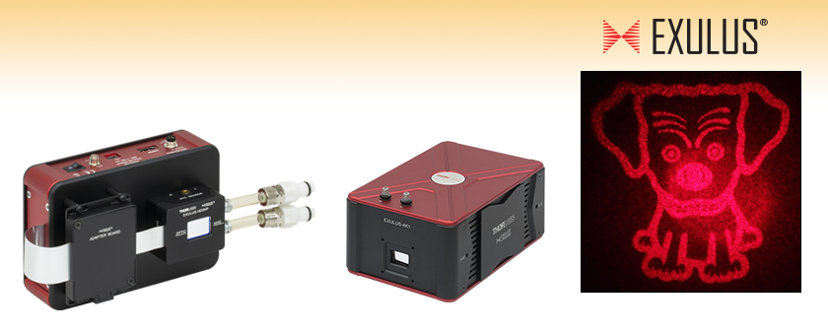
Spatial light modulators (SLM)
Rarely used in Telecom
Is like a pixelated display but transmits or reflects light.
Creates a hologram or grating to change the spatial mode of an input laser
Used to correct for turbulent media

